Slide 1

Globo-Com Telecommunications Churn-Reduction Proposal
By Daniel Kuchan

Slide 2
Overview
Globo-com telecommunications currently has $2M in monthly, $24M in annual revenue.
Currently losing $320K monthly, $3.8M annually to other service providers (Churn).
14.5% of total customers and 16% of revenue annually.
Received proposals for churn reduction from:
Finance
Marketing
Sales
Operations

Slide 3


My Approach
Utilized Python Pandas notebook to clean and manipulate data
What is Pandas?
A data analysis and manipulation tool using the Python programming language
Why Pandas?
Best for tabular data
Scalable
Able to automate

Slide 4
Finance – Proposal
Proposal: Overall churn percentage is misleading, Globo-Com should reduce marketing spend in low-value customers whose churn has low financial impact to increase profitability.
Assumptions:
Marketing spend is allocated equally across customers of all sizes.
Churn percent is based on number of churn customers and not total spend of churn customers.
Relevant Metrics:
Churn Percentage = Churn Customers / Total Customers
Total Spend = Day Charge + Eve Charge + Night Charge + Int’l Charge

Slide 5
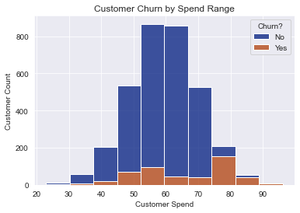
Finance - Analysis
Customer Churn % = 14.5%
Looked at customer churn count rather than overall percentage
Broke out customers into spend ranges to determine largest churn segments
Created histogram to display distribution of churn customers

Slide 6
Finance - Analysis
SpendRange | Churn Spend | % Total Churn | Revenue Groups
$20 - $27.50 | $49.95 | 0.2% | 10.1% | Low
$27.50 - $35 | $164.37 | 0.5%
$35 - $42.50 | $478.61 | 1.5%
$42.50 - $50 | $2,500.46 | 7.9%
$50 - $57.50 | $5,799.67 | 18.4% | 37.3% | Med
$57.50 - $65 | $3,259.59 | 10.4%
$65 - $72.50 | $2,692.25 | 8.6%
$72.50 - $80 | $11,311.58 | 35.9% | 52.5% | High
$80 - $87.50 | $4,228.12 | 13.4%
$87.50 - $95 | $986.18 | 3.1%
Viewed impact of churn across these ranges
Determined Churn % in each customer range
Created new “Revenue Groups” to determine allocation of marketing funds

Slide 7

Finance - Recommendation
Recommendation: Accept Finance’s proposal to reduce marketing spend to low value customers.
Additional Considerations:
Viewing churn based on customer volume as percentage can be misleading.
Use “Revenue Groups” to allocate additional marketing spend to high-value customers who are driving Churn $
Explore additional reasons why high spend = high churn.

Slide 8
Marketing- Proposal
Proposal: Globo-Com should focus on it’s largest competitor, Average Joe’s Wireless, and follow their lead by expanding their international plan to more countries to reduce churn.
Assumptions: The additional cost of the international advertising campaign is negligible.
Relevant Metrics:
International vs. Non-International plan
International Calls
International Minutes
International Charges

Slide 9

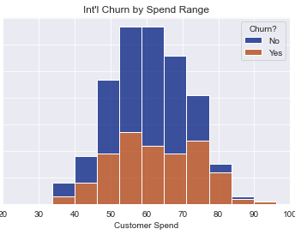
Marketing- Analysis
Looked at churn distribution in int’l customers
Compared to overall distribution
Clear image of higher churn in int’l plan customers, but why?

Slide 10
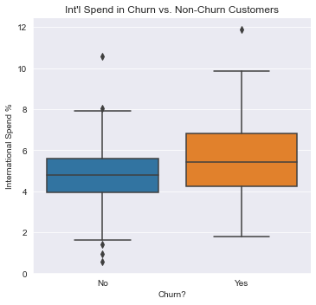
Marketing- Analysis
Only about 10% of customers currently using int’l plan
Int’l plan makes up 27% of Overall Churn $
However, actual spend on int’l calls is low in both Churn and Non-Churn Int’l customers
Why aren’t International Plan participants making more international calls?

Slide 11
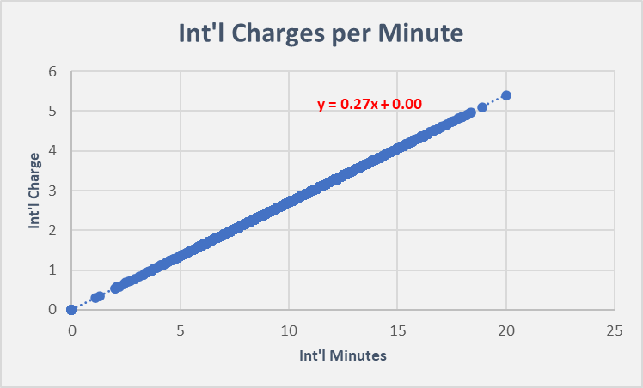
Marketing- Analysis
Charging $0.27 per minute across all int’l customers regardless of plan
$0.10 per minute more than daytime plan
No apparent benefit to enrolling in the international plan

Slide 12
Marketing- Recommendation
Recommendation: Reject Marketing proposal to expand international offerings.
Int’l plan customers heavily overlap with high spend customers, could be causing churn
Evidence that int’l plan customers do not heavily utilize the service.
Hard to attribute churn to low int’l representation, more likely high cost and lack of value.
Additional Considerations:
Consider reducing $0.27 per minute International charge
Discount customers with International plan

Slide 13
Sales- Proposal
Proposal: Globo-Com should hire 10 additional heads to customer service at a cost of $400K annually to help reduce churn
Assumptions:
Globo-com struggles with current customer service volume
Additional Service Reps will help minimize Customer Service call count
Relevant Metrics:
Customer Service Calls
Customer Spend
Churn Percent

Slide 14
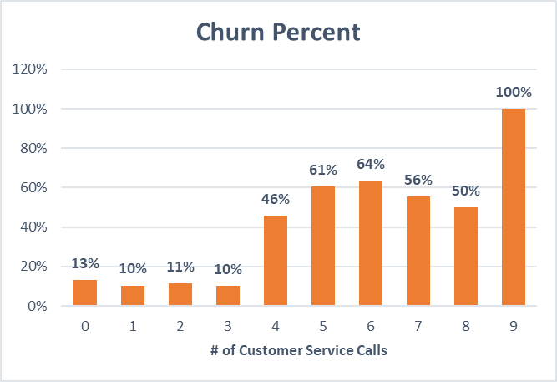
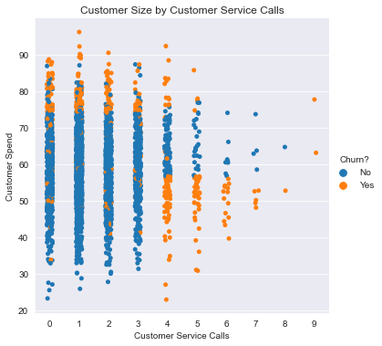
Sales- Analysis
72% of churn $ came from customers with at least one customer service call
View percentage of customer churn across each call volume
Some of the low volume call churn is coming from high spend customers
Reducing call volume from 4+ call range to the 0-3 would reduce churn $ by ~$800K/yr

Slide 15
Sales- Recommendation
Recommendation: Accept Sales proposal to add additional customer service reps
Additional Service Reps will help minimize Customer Service call count
Lower call count will translate to less churn based on churn% per call
$400K annually will reduce at least $800K in churn

Slide 16
Operations- Proposal
Proposal: Operations wants additional resources to build a predictive model that will analyze customer behavior for relationship programs that will reduce churn.
Assumptions:
Operations has already identified trends in certain customer segments

Slide 17
Operations- Recommendation
Recommendation: Accept Operations’ proposal to further explore trends that might mitigate $3.8 M in annual churn
Finance analysis shows relationship issues with high-value customers
Marketing analysis shows issues with company offerings and how to add value to customers
Sales analysis has proven customer service issues
Improved retention has been shown to increase revenue by up to 80% over a 24-month period
Can likewise reduce customer acquisition costs up to 30%
Citation: (https://www.toptal.com/finance/venture-capital-consultants/the-importance-of-customer-retention-an-empirical-study)

Slide 18
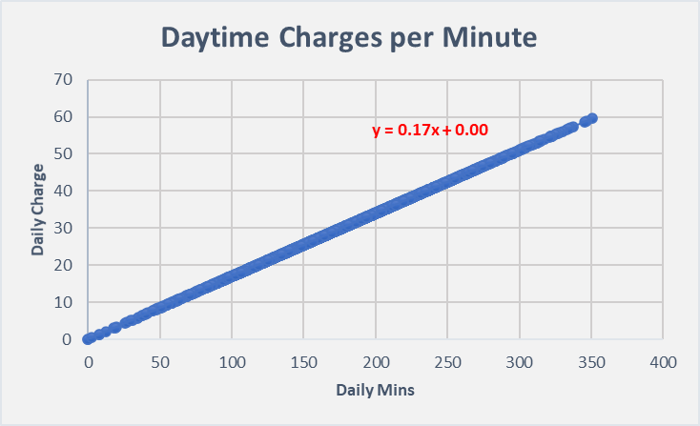
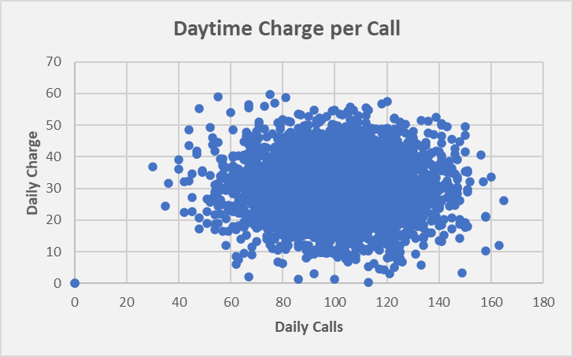
Additional Recommendations
Globo-com should consider a scaled pricing model:
Customers are charged equally regardless of total spend
Can risk higher churn for margin gain at low-value customers
Can incentivize high-value customers with lower price to reduce churn
Plan | Rate
Daytime | $0.17 per min
Evening | $0.085 per min
Night | $0.045 per min
International | $0.27 per min

Slide 19
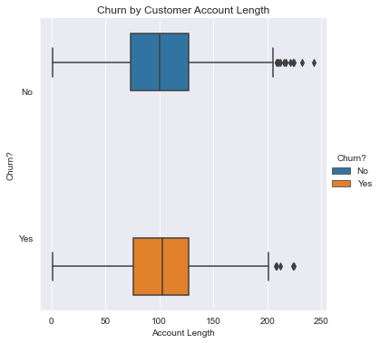
Additional Considerations
Does higher account length result in higher churn?
Do certain geographical areas result in higher churn?
Do night or evening users experience more churn?

Slide 20





Questions?

